Slide 1
Mathematical series and sums
Eric Prebys

Slide 2
Digression: Euler Relations
If we put an imaginary argument into the exponential expansion
You’ll use these relationships a lot!

Slide 3
Mathematical Sequence
In mathematics, a sequence is an enumerated collection of objects in which repetitions are allowed and order matters
  May be finite or infinite
Example: Prime numbers
  1,3,5,7,11,13,17,19
  No known generation or recursion algorithm for ALL prime numbers.
Generation algorithms
  Index-based: Each element is determined by some function of the index, independently from the other terms
  Recursive: Each element is determined from some combination of the previous terms

Slide 4
Recursive Example: Fibonacci Series
From Wikipedia:
  “The Fibonacci numbers were first described in Indian mathematics as early as 200 BC in work by Pingala on enumerating possible patterns of Sanskrit poetry formed from syllables of two lengths. They are named after the Italian mathematician Leonardo of Pisa, also known as Fibonacci, who introduced the sequence to Western European mathematics in his 1202 book Liber Abaci.”
The Fibonacci Series begins with 0 and 1, and after that, each term is the sum of the previous two terms:

Slide 5
Programming hints to generate Fibonacci Sequence
The first two elements are special
If you want values beyond the 2nd, you will need to repeat a recursive algorithm n-2 times
Then return the final value of F_{c}
Why is it important that I do it in exactly this order?

Slide 6
Alternative Approaches
You’re not being asked to do this yet, but you could generate the entire Fibonacci Sequence up to n by filling an array
(Go to notebook)

Slide 7
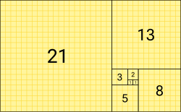
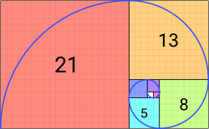
Visualizing the Fibonacci Series
Fibonacci Tiling
Fibonacci Spiral (Approximation of Golden Spiral)

Slide 8
Digression: The Golden Ratio
In mathematics, two quantities are in the golden ratio if their ratio is the same as the ratio of their sum to the larger of the two quantities.

Slide 9
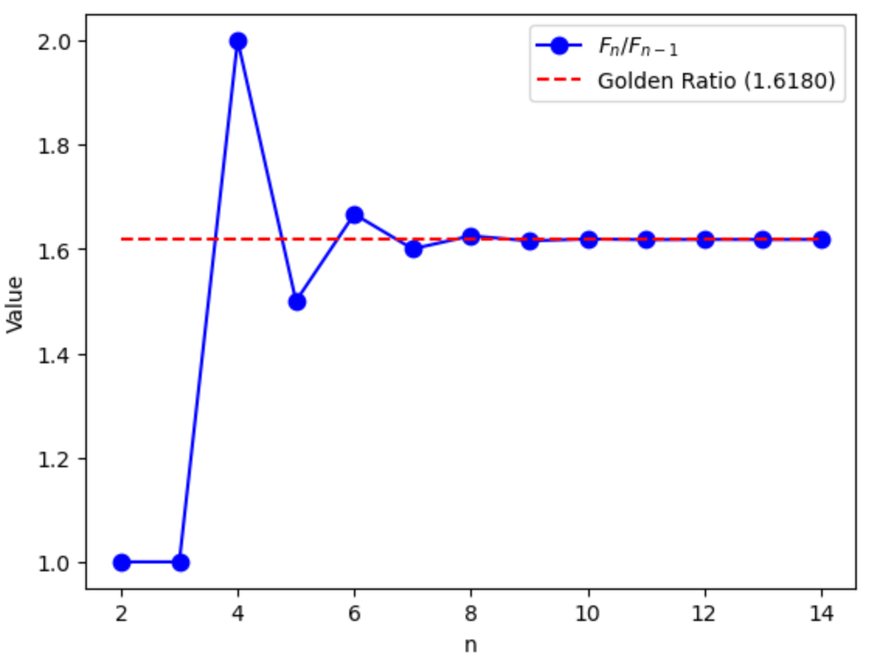
The Fibonacci Series and the Golden Ratio
The ratio of subsequent terms in the Fibonacci Sequence quickly converges on the Golden Ratio (go to notebook)

Slide 10
Fibonacci Series and Perfect Triangles
Starting with the value 5, every 2nd number in the Fibonacci sequence is a perfect triangle, ie
First two
You’ll find the next two in lab, and I recommend you just write a loop that looks at
for i<n and see which value you gives you and integer

Slide 11
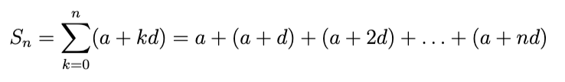
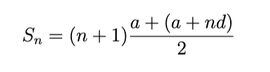
Arithmetic Series
An arithmetic series is one in which the difference between successive terms are constant, then the terms are all summed.
Which sums to the average of the first and last terms times the number of terms.

Slide 12
Geometric Series
A geometric series is one in which the terms are powers
Note

Slide 13
Taylor Expansion (you’ll use this a lot)
A power series provides a basis to represent any function
We can also represent a series about an arbitrary point a that is not 0
Note! Obviously, I could expand the terms in the second form and put it in the form of the first, but it’s more useful in this form for…

Slide 14
Taylor Expansion (cont’d)
Two functions are equal if their values and ALL of their derivatives are equal. Considering our expansion

Slide 15
Calculating the Coefficients
If I’m trying to represent a known functional
form, I can use this to calculate the coefficients
I can then redefine my series as

Slide 16
Maclaurin Series
A Maclaurin Series is a special case of a Taylor Series, expanded about zero*.
*Most people still just call it a Taylor Series

Slide 17
e^{ax}
Note! Sign will alternate if a is negative

Slide 18
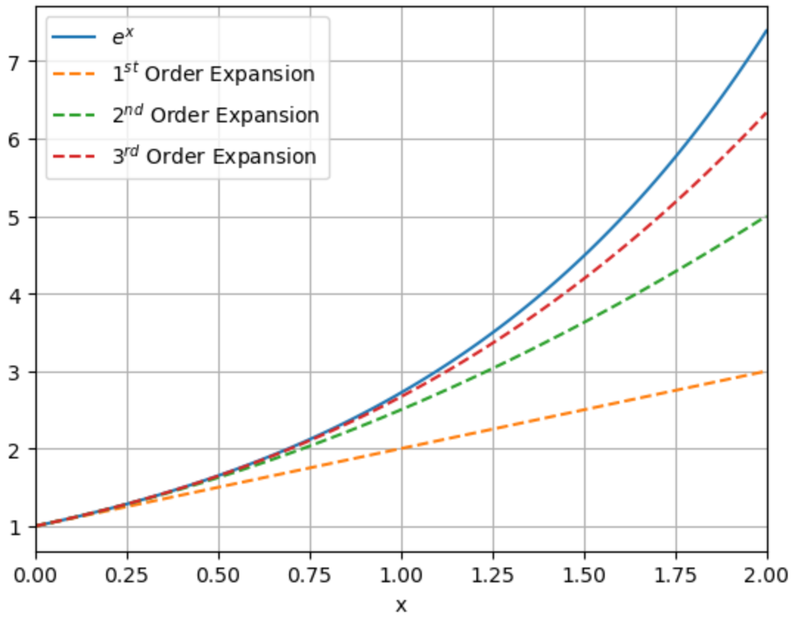
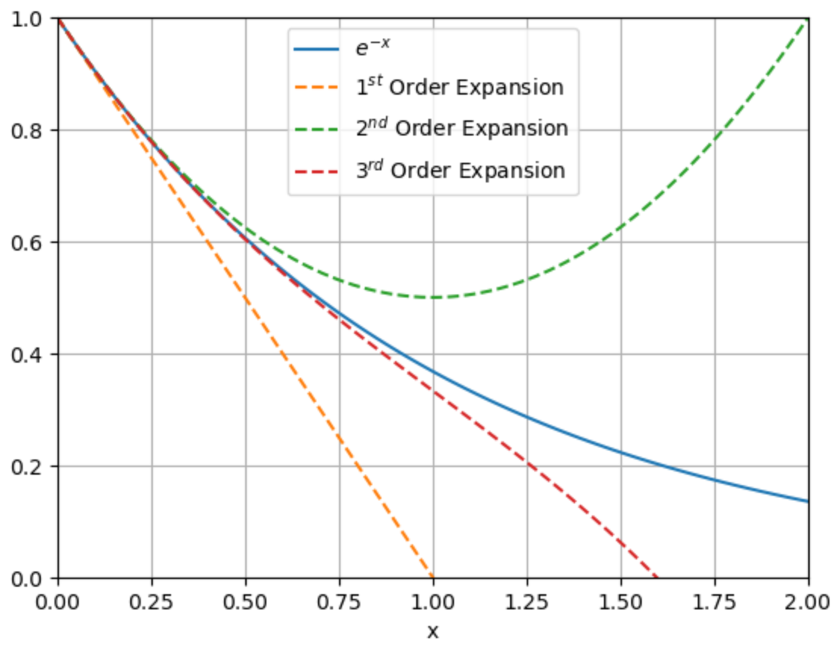
Accuracy (See Notebook)

Slide 19
sin(x)
Only odd terms

Slide 20
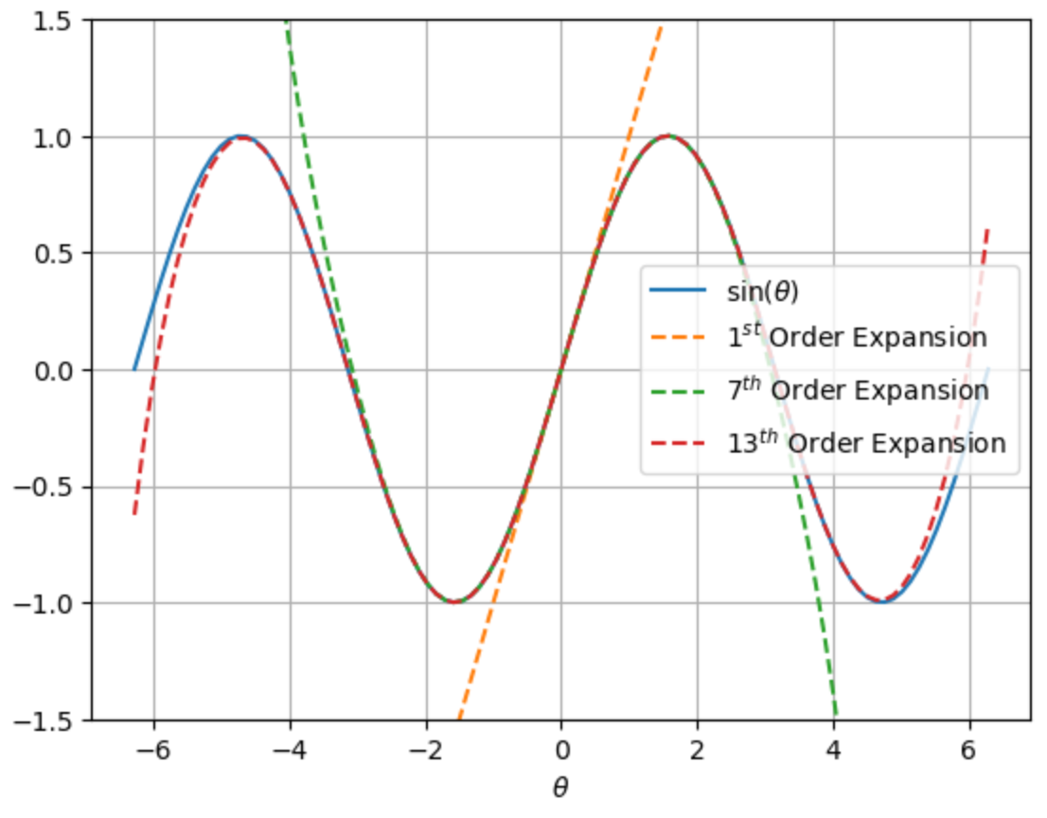
Sine Accuracy
Need a lot of terms

Slide 21
cos(x)
Only even terms

Slide 22
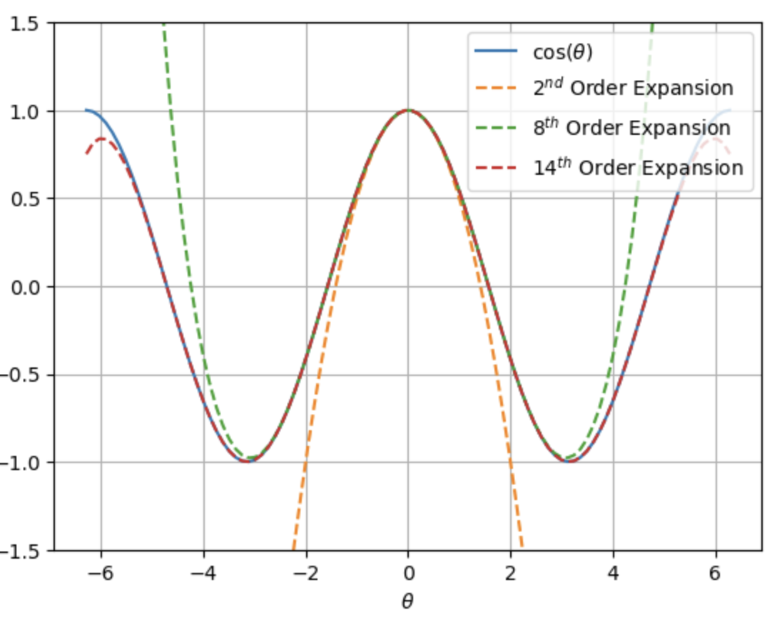
Cosine Accuracy
2nd order is a parabola

